Slide 1

Command Pattern
Dmytro Razvaliaiev
Student ID: 63751
Vistula University

Slide 2
What is Command Pattern about?
Command Pattern adds a level of abstraction between actions and includes an object, which invokes these actions.
In this design pattern, client creates a command object that includes a list of commands to be executed. The command object created implements a specific interface.

Slide 3
Definitions
Command: This is an interface that is responsible for executing the requests.
Client: This creates a concrete class, and it is attached to the receiver's end.
Concrete Command: Binding between action and receiver is important, which is done by concrete Command. The interface is extended by it.
Invoker: Command is subjected to execute the request by the invoker. The invoker object is responsible for searching for the appropriate handler of the request and passing the Command to the corresponding object, and that object executes the Command.
Receiver: The necessary actions and tasks are performed using the receiver.

Slide 4
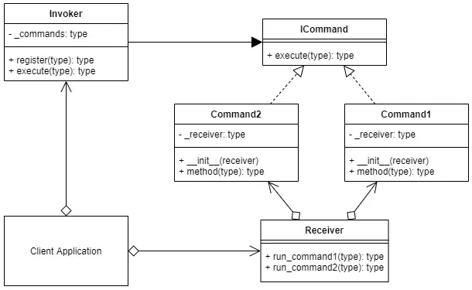
Command UML Diagram

Slide 5
When is it useful?
state_and_city
When:
it is necessary to parametrize objects by the action to be performed;
when requests need to be queued or scheduledж
when it is important to be able to support undos or logging of changes.

Slide 6

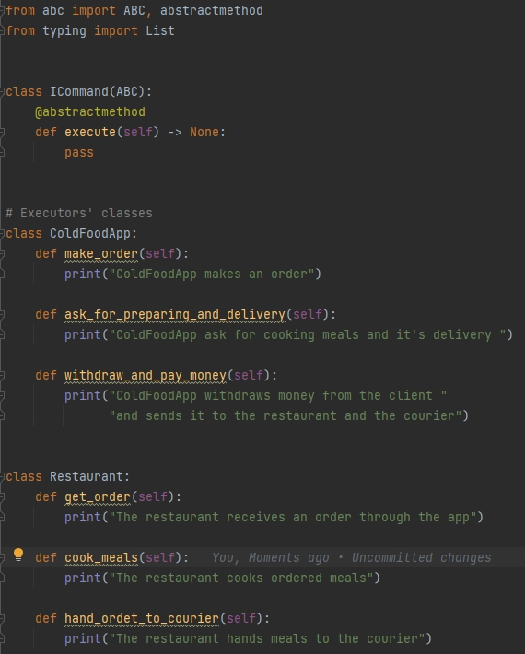
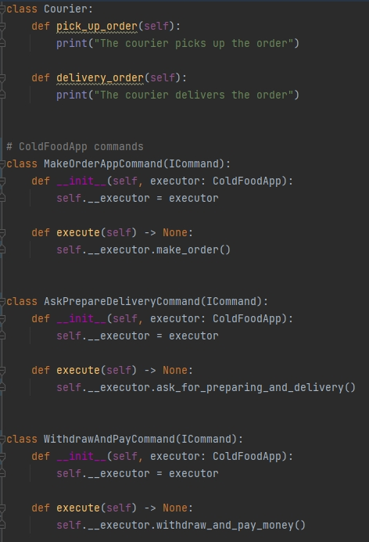

Slide 7
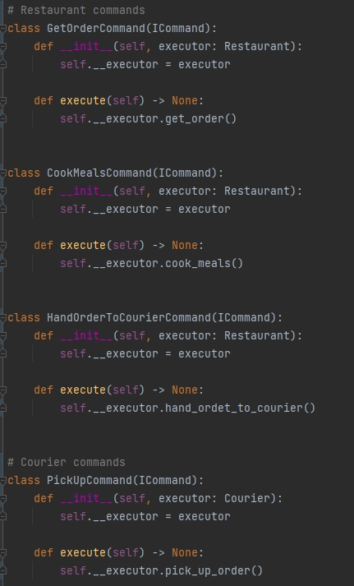
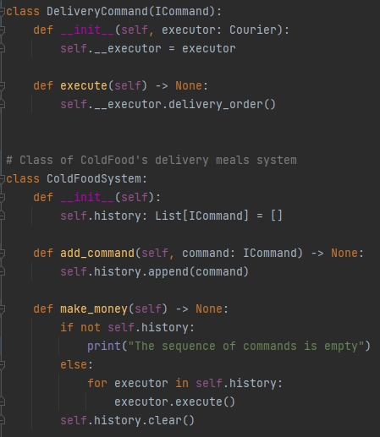

Slide 8
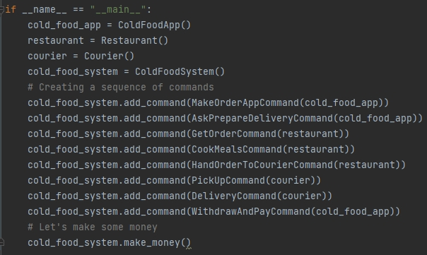
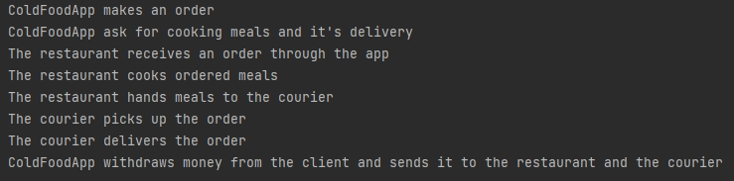

Slide 9
Advantages and disadvantages
state_and_city
Advantages | Disadvantages
The class is decoupled, which helps in invoking the operation from the desired object, and then the program is executed. We use a queue system for Command to boost the software's performance. We can add new Commands very easily, and it does not affect the basic structure of the code. Adding a new subclass through the conventional method is poor practice, making software less efficient, so using command design patterns is helpful and efficient. It can consist of the functionality of the roll-back system. | The developer needs to be careful while creating the classes, as there are several classes. Each class works as a concrete class which is the major drawback.

